Slide 1

Asset Accumulation,
Protection, Preservation, and Transfer, LLC
Copyright © 2013

Slide 2

Blairsville/Blue Ridge
August, 2013
Copyright © 2013

Slide 3

Asset Accumulation,
Protection, Preservation, and Transfer, LLC
Go Navy!
Copyright © 2013

Slide 4
Disclosure
The information and material contained in this presentation is of a general nature and is intended for educational purposes only. This presentation does not constitute a recommendation or a solicitation or offer of the purchase or sale of securities. Furthermore, this presentation does not endorse or recommend any tax, legal, or investment-related strategy. The future performance of an investment or strategy cannot be deduced from past performance. As with any investment or investment strategy, the outcome depends upon many factors including: investment objectives, income, net worth, tax bracket, risk tolerance, as well as economic and market factors. Before investing or using any strategy, individuals should consult with their tax, legal, or financial advisor. All information contained in this presentation has been derived from sources deemed to be reliable but cannot be guaranteed.
Copyright © 2013

Slide 5

Asset Accumulation, Protection, Preservation, and Transfer, LLC
Registered Investment Advisory Firm
John A. Cory, Member
(Your Wealth/Legacy Planner/PractitionerTM)
Securities offered through Resource Horizons Group, L.L.C., Broker-Dealer, Member FINA, SIPC
Copyright © 2013
Notes:
Talk about my credentials

Slide 6
Compensation
generally
Resource
Horizons
Group, L.L.C.
commission
FINRA
AAPPT, LLC
fee
GA Securities
SEC
ADV
Copyright © 2013

Slide 7

Fee versus Commission
RIA: Fiduciary duty
Broker Dealer: Suitability
Compensation: Investment vehicle or product
Copyright © 2013

Slide 8
Relationship
Advisory Services through AAPPT, LLC
Securities through Resource Horizons Group, L.L.C., Broker-Dealer, Member FINA, SIPC
AAPPT, LLC is not otherwise affiliated with Resource Horizons Group, L.L.C.
Copyright © 2013

Slide 9

Planning
Financial Investment
Retirement Estate
Tax
Implementation
Copyright © 2013

Slide 10

Uncertain World
Political: Afghanistan, Iran, Terrorists, Korea, China, India/Pakistan, Egypt, Syria
Economic: Budget Deficits, Uncontrolled Spending, Congress, Europe
Copyright © 2013

Slide 11
American Taxpayer Relief Act of 2012
$5.25M Transfer Tax Exemption in 2013
Flat Tax Rate of 40%
Permanent Spousal Portability-Estate & Gift; not GST (generation skipping tax)
Source: American Taxpayer Relief Act of 2012
Copyright © 2013

Slide 12
Unified Credit
2013
$5M
2009
$3.5M
2006
$2M
2004
$1.5M
2002
$1M
Source: Heckerling Institute on Estate Planning
Copyright © 2013

Slide 13
History of Estate Tax
1797: Stamp Act
1802: Repealed
1862: Civil War
1870: Repealed
1898: Spanish American War
1902: Repealed
1916: WW I
1924,1930’s,1976 – 1993 (9 Acts)
2001: EGTRRA
American Taxpayer Relief Act of 2012
Source: Heckerling Institute on Estate Planning
Copyright © 2013

Slide 14

Agenda
Reasons for Trust
Trust: Trustor (Grantor) (Settlor), and Trustee, Beneficiary
Revocable Living Trust
QTIP (Qualified Terminable Interest in Property) Trust – second marriages, stepchildren
Unified Credit/Exemption Equivalent Trust
Spousal Lifetime Access Trust
Spendthrift
Life Insurance Trust
Special Needs Trust
Taxation – simple, complex; capital gains; rates
Income Tax Basis/Gift Tax Return
Q: Should you create, amend, modify or do away
with your Trust in the context of your Estate,
Retirement, and Investment planning?
Copyright © 2013

Slide 15
Agenda (cont)
Incentive Trust
Nursing Home Planning Trust
Health and Education Exclusion Trust For Grandchildren
Charitable Remainder Trust
Charitable Lead Trust
IRA Trust
Generation Skipping Trust
Dynasty Trust
Situs- GA, Delaware, Nevada, Alaska, South Dakota
Trustee Selection
Asset Protection - LLC’s, LLLP’s, FLLLP’s
ss
Q: Should you create, amend, modify or do away
with your Trust in the context of your Estate,
Retirement, and Investment planning?
Copyright © 2013

Slide 16
Trusts as Estate Planning Tools
  Trusts are one of the most flexible of estate planning tools
  They are set up during your life
  Can be funded while living or at death
  Allow distribution of wealth in a tax-advantaged way while alive
  Allow distribution of wealth in a tax-advantaged way at death
  Long term control on your terms…who gets what when
Copyright © 2013

Slide 17
Reasons for Trust
Control, Flexibility, but Cost
Mental Incapacity...Asset/Creditor Protection…
Divorce/Alimony/Child Support…
Estate /Income Tax Reduction…Second Marriages…
Step Children…Drug/Alcohol Dependencies…
Value Incentives…Special Needs…
Life Insurance…IRA…Charity…Disability…
Nursing Home Planning…Grandchildren Health and Education…Generation Skipping
Copyright © 2013

Slide 18
Trust Basics
Trustee
Trust Document
Grantor
Beneficiary
Beneficiary
Beneficiary
Copyright © 2013

Slide 19
Use of Trusts in Planning
Living Trust - Intervivos
  Funded during life (retitle assets)
  Revocable
  Management and planning tool
  Taxable in estate
  Not subject to probate
Irrevocable Trust - Testamentary
  Funded during life (gifts) or upon death
  Once funded, can not be changed
  Removes asset from estate
  Tax advantages
Copyright © 2013

Slide 20
How a Living Trust Works
  Revocable, flexible
  Asset gatherer, money manager
  Puts in place a plan (you still need a will)
  Protection for incompetence
  Becomes estate plan with pour over will
  Taxable in estate, avoids probate
  Perhaps avoid ancillary probate
  Self trusteed with successor named
Copyright © 2013

Slide 21
Duties of a Trustee
  Acceptance of Trusteeship
  Initial Administrative Duties
  Adhere to strict code of fiduciary responsibilities
  Tax responsibilities
  Investment guidelines/Diversification
  Exercise powers prudently
  Financial duties to current and remainder beneficiaries
Copyright © 2013

Slide 22
Selection of Trustee
  Experienced in trust accounts, accounting, auditing, administration and investments
  Access to experts in legal, investment and tax and estate decisions
  Available…long term
  Independent oversight
  Objective…fair and impartial decisions
  How compensated?
Copyright © 2013

Slide 23
Agenda
Reasons for Trust
Trust: Trustor (Grantor) (Settlor), and Trustee, Beneficiary
Revocable Living Trust
QTIP (Qualified Terminable Interest in Property) Trust – second marriages, stepchildren
Unified Credit/Exemption Equivalent Trust
Spousal Lifetime Access Trust
Spendthrift
Life Insurance Trust
Special Needs Trust
Taxation – simple, complex; capital gains; rates
Income Tax Basis/Gift Tax Return
Q: Should you create, amend, modify or do away
with your Trust in the context of your Estate,
Retirement, and Investment planning?
Copyright © 2013

Slide 24
Agenda (cont)
Incentive Trust
Nursing Home Planning Trust
Health and Education Exclusion Trust For Grandchildren
Charitable Remainder Trust
Charitable Lead Trust
IRA Trust
Generation Skipping Trust
Dynasty Trust
Situs- GA, Delaware, Nevada, Alaska, South Dakota
Trustee Selection
Asset Protection - LLC’s, LLLP’s, FLLLP’s
ss
Q: Should you create, amend, modify or do away
with your Trust in the context of your Estate,
Retirement, and Investment planning?
Copyright © 2013

Slide 25
Trust/IRA Issues
MRD
Designated Beneficiary
Rollover
Inherited
Age at Death
Copyright © 2013
Notes:
Alternatively, if there are multiple beneficiaries, all of whom are individuals, then the life expectancy of the oldest beneficiary must be used.

Slide 26


Important Dates for the
Year AFTER Death
9/30
DB determination
12/31
Separate accounts
Copyright © 2013
Notes:
These dates become critical in this planning:
9/30 the year after the owner’s death is the designated beneficiary date.
12/31 the year after the owner’s death is the separate account date.

Slide 27

Stretch IRA
OWNER
SON
GRANDCHILD
IRA
ACCOUNTS
IRA
ACCOUNTS
IRA
ACCOUNTS
No Stretch IRA
®
OWNER
Loses Tax Deferral
Taxes Due on Full Amount
No Legacy Left for Children
Oldest Beneficiary Life Expectancy
IRA
ACCOUNTS
SON
Copyright © 2013

Slide 28
BUILDING A TRUST INVESTMENT PORTFOLIO
Constraints – COST, Taxes, Liquidity
Legal – Prudence, Diversification, Income versus Remainder Beneficiary
Risk Level – Conservative, Moderate Conservative, Moderate, Moderate, Growth, Max Growth
Market Outlook – Bullish, Neutral, Bearish
Phase – Accumulation, Distribution, Time/Timing
Asset Allocation Approaches – Strategic, Tactical, Absolute Return, Alternative Investments
Allocation Ranges and Percentages, Rebalancing
Mode – Specific Money Manager, Turnkey Solution
INVESTMENT POLICY STATEMENT
Copyright © 2013

Slide 29
Capital Market Outlook
Federal Debt
State Debt
Central Banks print money (stimulus)
How will governments “unwind”
Political Events/Health Care
Country Debt/Budget Deficits (Sovereign risks)
Bank Debt/Credit Markets
Weak dollar (Currency)
Low but increasing interest rate (inflation)
Unemployment
Manufacturing Sector
Stock Market/Regulation
Commodities/oil and gas
Taxes: income tax increases
Residential/Commercial real estate
Copyright © 2013
Notes:
So where do we stand? Stronger equity markets, fewer layoffs, and sparks of life in the auto, manufacturing and housing sectors – are all good reasons for investors to feel better about the economy and their own situation.
But there are negative indicators to consider, including stubborn unemployment and reluctant consumers. These suggest that the economy still faces a number of challenges.
And while layoffs have slowed, we’re still not adding jobs at any significant level. In fact, the rate of new claims for unemployment benefits continues to rise, if ever slightly.
However, let me remind you that this is to be expected. Employment is considered a “trailing indicator,” which means it’s the last thing to recover, and we’ll see significant job growth only after the recession is clearly over.

Slide 30
Think positive, remain cautious
But be realistic…..
Economic tailwinds
Improving equity markets
Increased manufacturing activity
Reviving auto market
Economic headwinds
Employment level remains troubling
Commercial real estate
Cautious consumer spending, but perking up
Copyright © 2013
Notes:
So where do we stand? Stronger equity markets, fewer layoffs, and sparks of life in the auto, manufacturing and housing sectors – are all good reasons for investors to feel better about the economy and their own situation.
But there are negative indicators to consider, including stubborn unemployment and reluctant consumers. These suggest that the economy still faces a number of challenges.
And while layoffs have slowed, we’re still not adding jobs at any significant level. In fact, the rate of new claims for unemployment benefits continues to rise, if ever slightly.
However, let me remind you that this is to be expected. Employment is considered a “trailing indicator,” which means it’s the last thing to recover, and we’ll see significant job growth only after the recession is clearly over.

Slide 31


Slide 32
We believe there are times to take advantage of the market environment and times when the priority is simply to avoid market risk. This is why we feel a flexible approach to investing is needed.

Slide 33
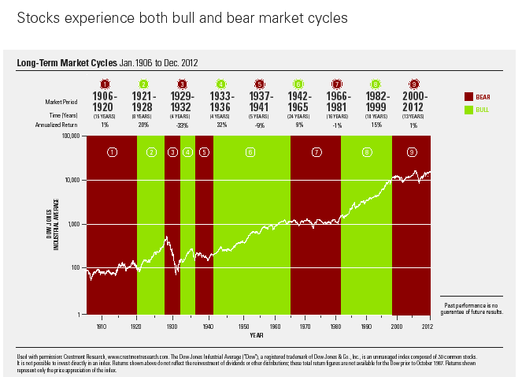

Slide 34
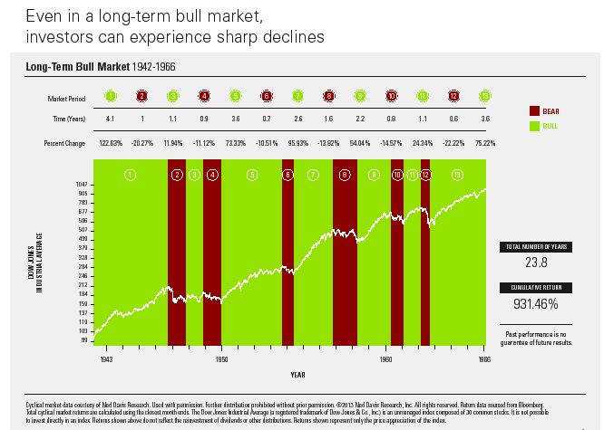

Slide 35
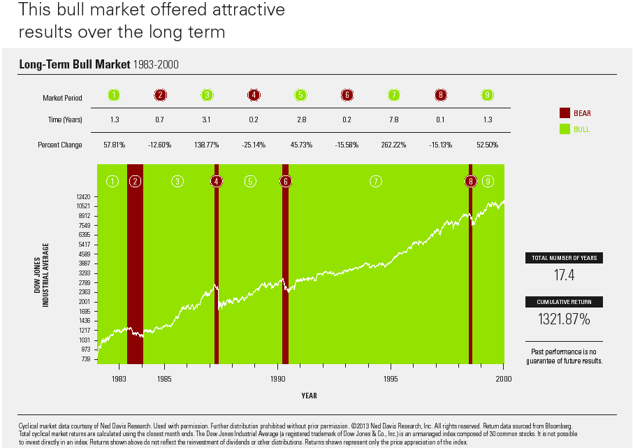

Slide 36
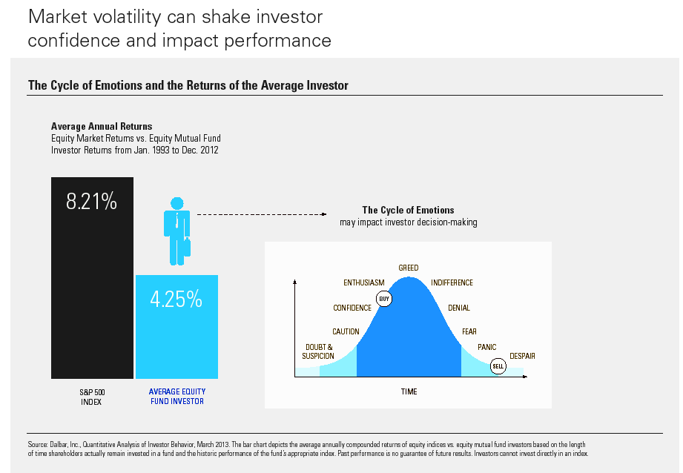

Slide 37
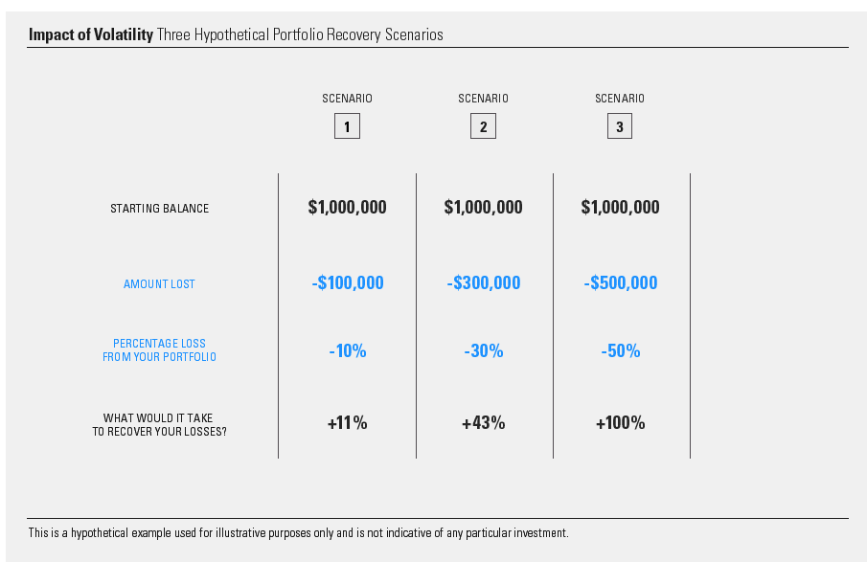

Slide 38
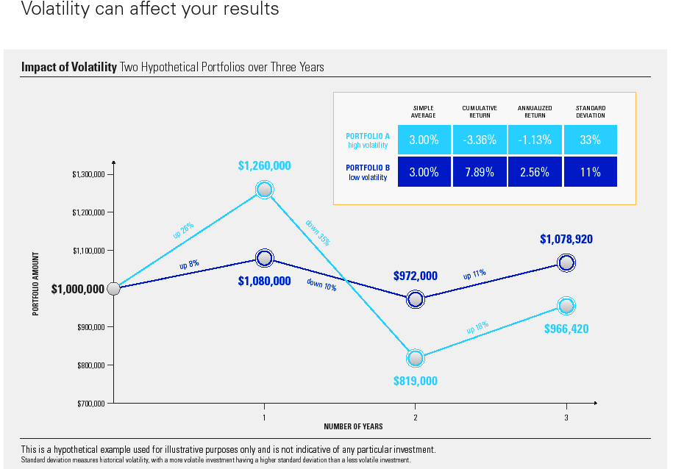

Slide 39
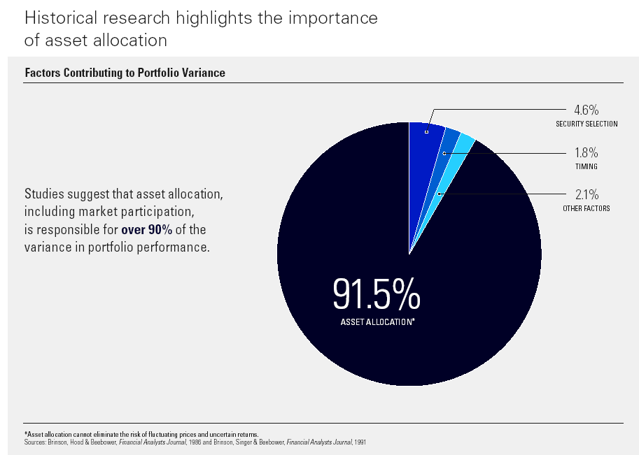

Slide 40
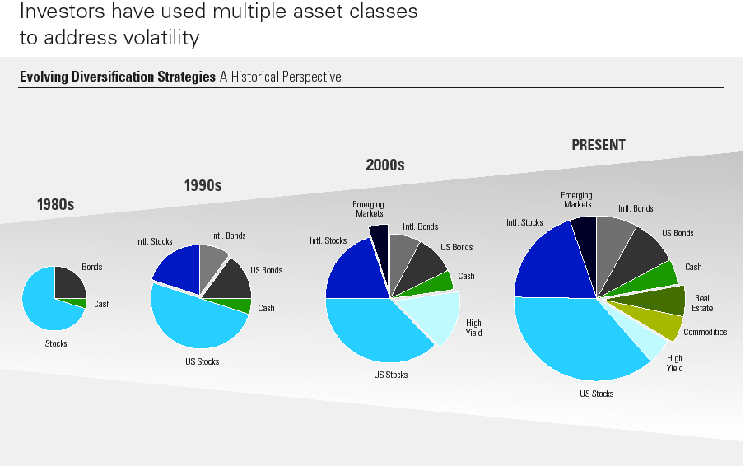

Slide 41
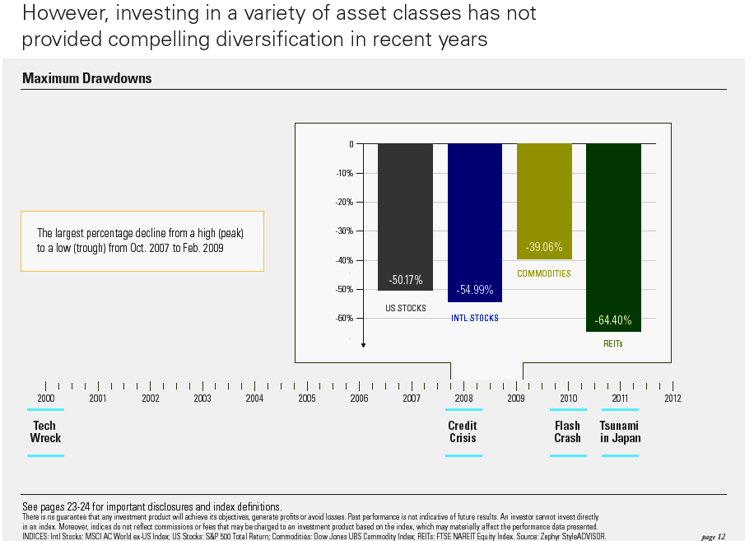
See important disclosures and index definitions
Copyright © 2013

Slide 42
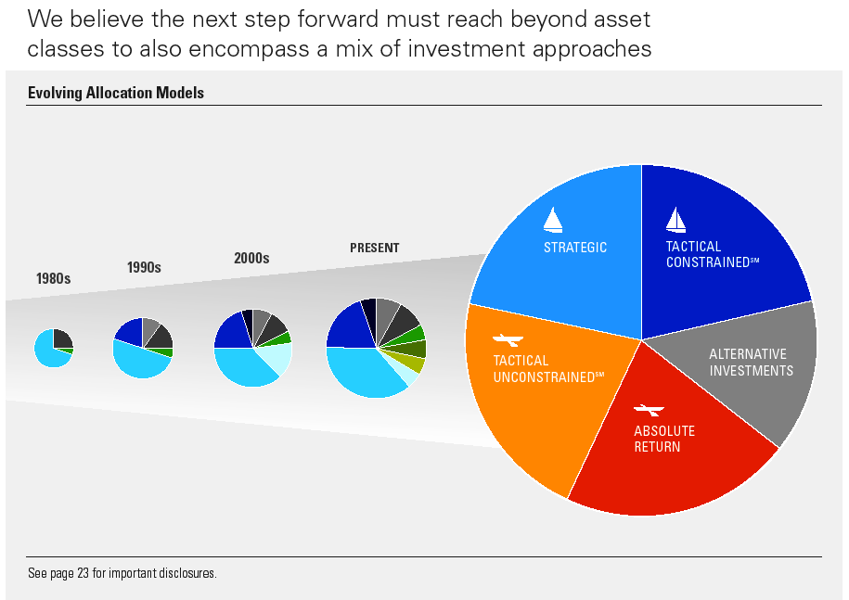
Copyright © 2013

Slide 43
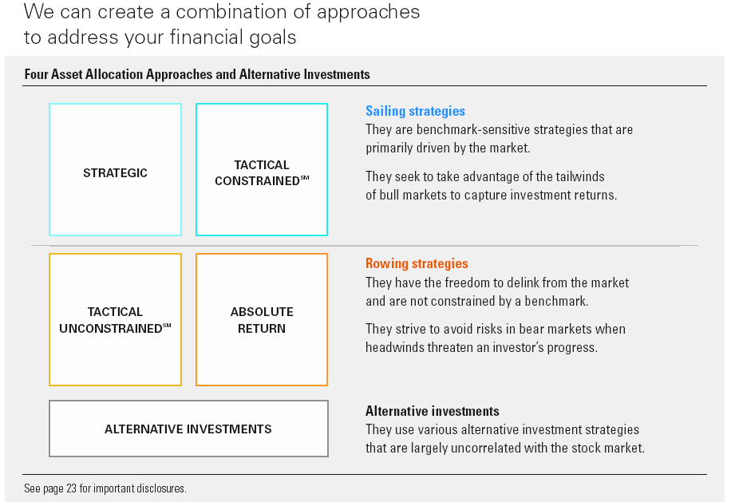

Slide 44
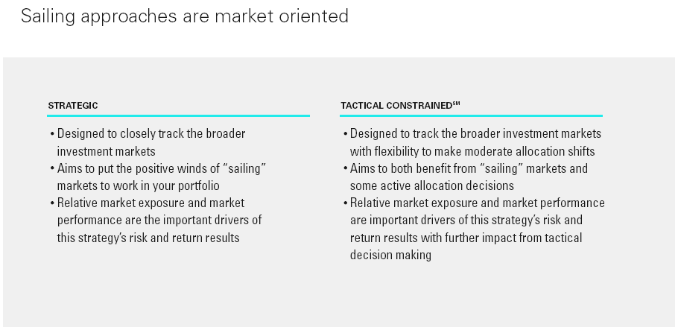

Slide 45
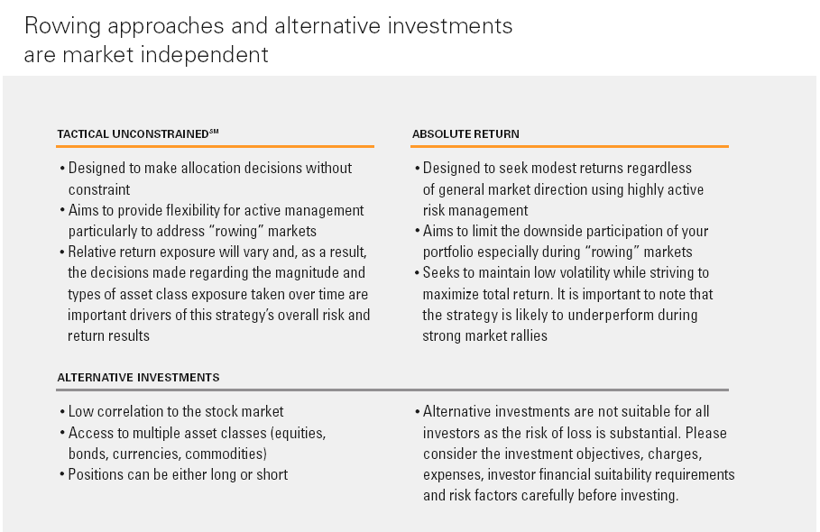

Slide 46
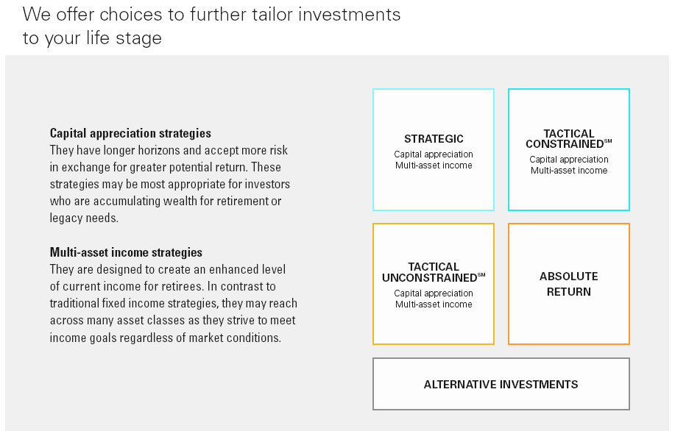

Slide 47
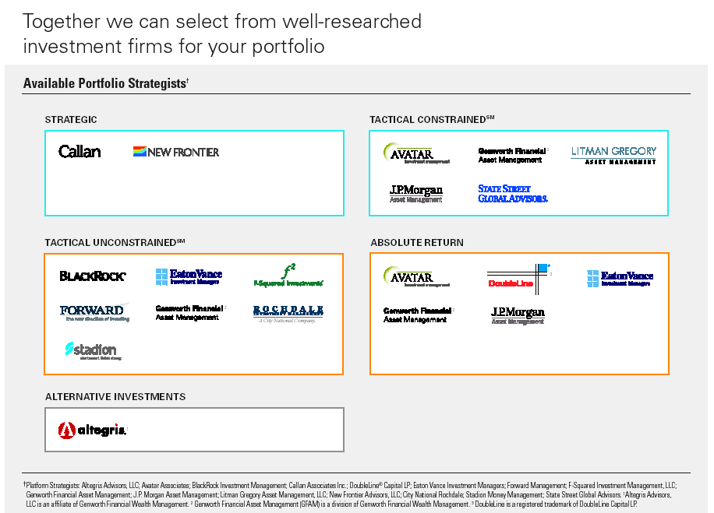

Slide 48
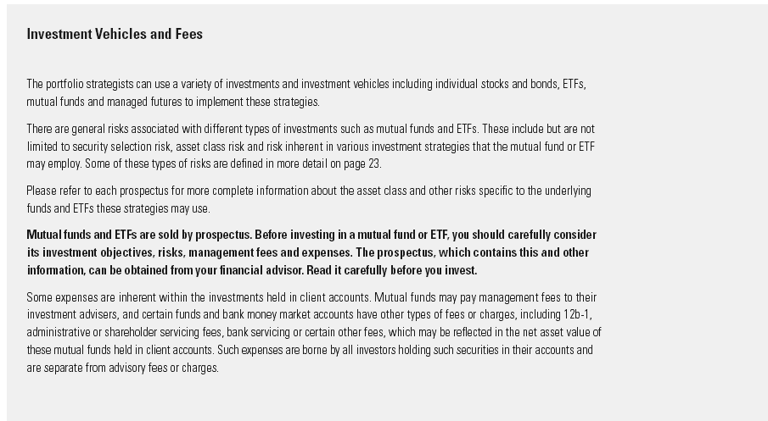

Slide 49
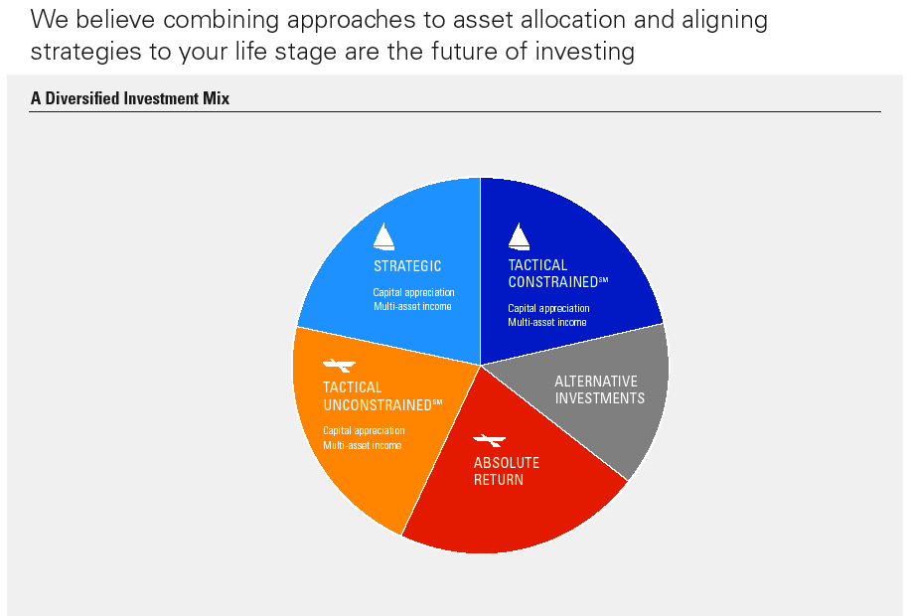

Slide 50
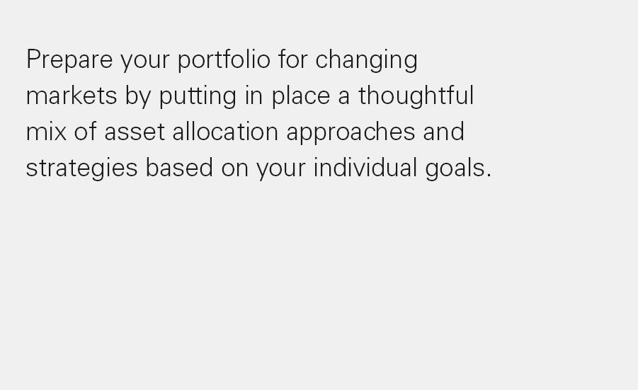

Slide 51

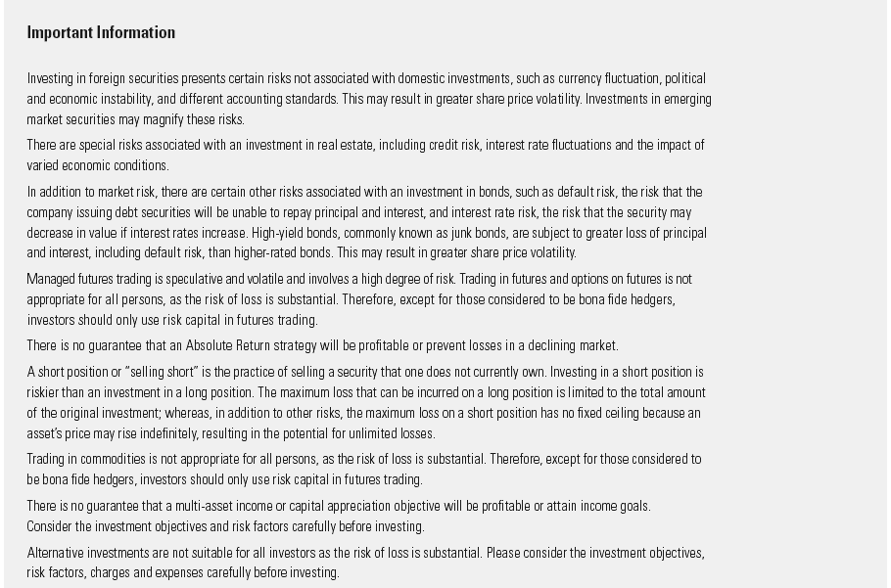

Slide 52
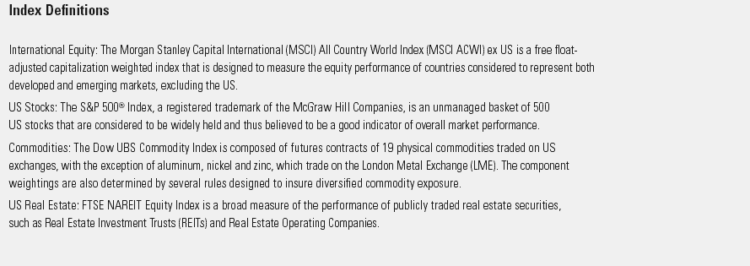

Slide 53
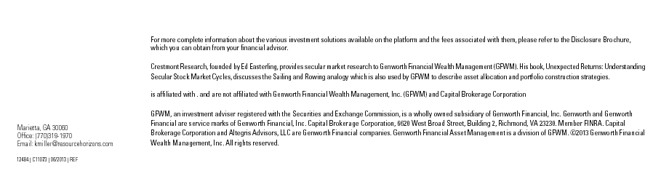

Slide 54
Investing : Ask the right questions
What are your investment objectives?
What role does the investment vehicles you’re considering play in meeting objective?
How will the timing of your buy affect your return?
Are you willing to practice patience and not sell after a negative year?
Are you properly diversified beyond the investment you’re making in any one fund?
Are you willing to keep your sights focused far down the road?
Copyright © 2013
Notes:
What are the right questions? To begin with, it’s not a good idea to do anything without first identifying your objective. Whether you’re building a house, planning your career or shopping for mutual funds. Your investment objectives will help define your investment strategy.
What role will this fund play in meeting your objectives? Is it your only investment? If the answer is yes, then you’re probably not sufficiently diversified.
How will the timing of your buy decision affect your return? Are you too late? Has the price gotten so high that it’s likely you missed the opportunity? If you think there is room for more growth, how patient can you be in the event of a correction. Quick killings are rare in this business. Generally patience pays.

Slide 55
Investing: Believe in asset allocation
Consider changing your allocation only . . .
  When your situation changes
  When there is a change in the risk-reward tradeoff in markets
Do not change your asset allocation out of fear or greed
  We can help you modify an allocation appropriate for your goals
Copyright © 2013
Notes:
While buy and hold remains the best strategy for long-term growth, there are legitimate reasons to change your level of risk. The most obvious is when your situation changes, for example as you near retirement, see your kids leave for college, or if there is a dramatic change in your financial situation.
It’s also worth considering a change if the fundamental assumptions about the markets have changed. Some have argued that the present crisis changed the relationship between equity and fixed income investments, dictating how we look at risk. We don’t believe that. Nothing fundamental has changed in our mind. While we have been sorely reminded that asset allocation has its limits as a risk control strategy, it STILL WORKS.

Slide 56
Investing: Rebalance regularly
Steep market changes can alter allocation dramatically
40%
40%
60%
60%
January 1, 2013
June 30, 2013
Your advisor can help you keep your portfolio on target
For illustration purposes only, not related to any investment
Copyright © 2013
Notes:
Picking and sticking with an asset allocation is a good start on becoming an All- Market Investor. But there is one more important step – rebalancing. The ratio of stocks to bonds in your portfolio will move over time as the markets gyrate. For example, if you selected a 60-40 allocation in April of this year, the dramatic increases in equity markets would have increased your overall exposure to equities and your level of risk. Investors should take on more or less risk when their situation changes, not let it drift up unintentionally. Investors should stick to their current allocation unless their situation changes significantly.

Slide 57
Planning and Implementation
Financial Investment
Retirement Estate
Tax
What is your blend of taxable, tax deferred,
and tax free investments?
Copyright © 2013

Slide 58
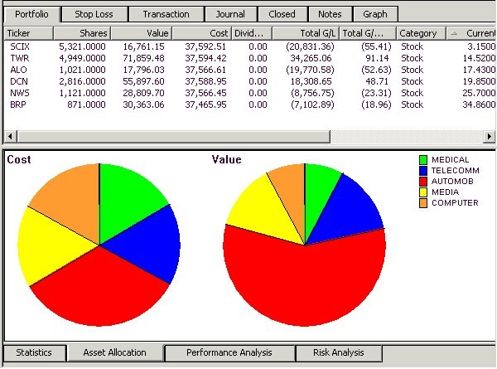
Portfolio Review
(for illustration purposes only, disregard the portfolio and numbers)
Diversification
Asset Allocation
Copyright © 2013

Slide 59
The Right Investments
Traditional IRA
(These old semi-thumb rules should be reexamined)
Inside IRA
Growth Mutual Funds
Short-Hold Stocks
Taxable Bonds
Outside IRA
Index/Low Turnover Mutual Funds
Long-Hold Stocks
Tax-Free Bonds
Roth IRA
Risk/Return Analysis
Time Horizon
Outside IRA: Income Tax Basis Planning
Copyright © 2013

Slide 60

Don’t Procrastinate!
Because…
Copyright © 2013

Slide 61

Question
What are you doing with your life’s resources,
gifts, talents, opportunities, and abilities?
Copyright © 2013

Slide 62



Life is like the
game of MONOPOLY…
When it’s all over, it all goes
back into the box.
Copyright © 2013

Slide 63

He was a great man, but…
…the one scenario he forgot to consider in his forecast, was the certainty of Death.
Copyright © 2013

Slide 64


Death is the
last big move of your
Life.
Copyright © 2013

Slide 65
Mission Statement
“provide unbiased, multi-generational, multidiscipline planning, across the board, investment, retirement, estate, business, and charitable advice and implementation, from an independent conservative/moderate but global investment prospective, enabling clients to meet and maintain material needs, instilling family values, and achieving financial goals and objectives, while making this world a better place.”
Copyright © 2013

Slide 66
THE END
Thank you for attending today’s session.
Time for 40 Questions
Copyright © 2013
Notes:
Call me to set up an appt.
Sign up in the back for a free consultation.
Other call to action advisor usually uses

Slide 67
Disclosures
There are risks involved with investing including possible loss of principal. This material represents an assessment of the market environment at a specific point in time and is not intended to be a forecast of future events, or a guarantee of future results.
Index performance returns do not reflect any management fees, transaction costs or expenses. Indexes are unmanaged and one cannot invest directly in an index. Past performance does not guarantee future results.
Copyright © 2013

Slide 68
Disclosure
Neither Asset Accumulation, Protection, Preservation, and Transfer, LLC (AAPPT, LLC) nor Resource Horizons Group, L.L.C. provide legal or tax advice. John A. Cory is and attorney and CPA. He has a MBA with emphasis in taxation and previously attained the Certified Financial Planner designation. However, the tax information contained herein is general and is not exhaustive by nature. Federal and state laws are complex and constantly changing. You should always consult your own legal or tax professional for information concerning your individual situation.
Copyright © 2013

Slide 69


Asset Accumulation,
Protection, Preservation, and Transfer, LLC
Go Dawgs!
Copyright © 2013

